Slide 1
效能測試入門
Jason Chen
2024/04/17

Slide 2
PART II : 效能測試工具簡介

Slide 3
In This Part ...
工具介紹
JMeter / BlazeMeter
動手練習
建立簡易腳本

Slide 4

Apache JMeter™
open source software
a 100% pure Java application
designed to load test functional behavior and measure performance
originally designed for testing Web Applications but has since expanded to other test functions
https://jmeter.apache.org/

Slide 5
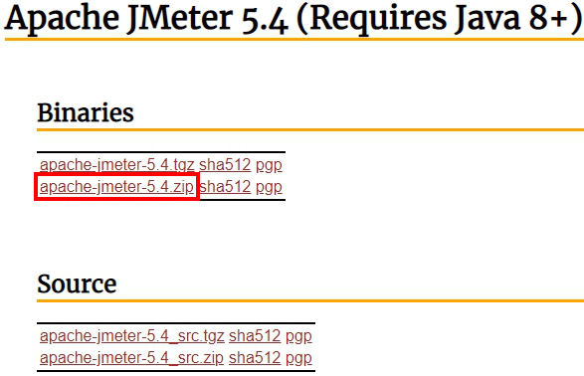
Acquire JMeter
Requires Java 8+
https://adoptium.net/temurin/releases/
Download Apache JMeter 5.6.3 (current version)
https://jmeter.apache.org/download_jmeter.cgi

Slide 6
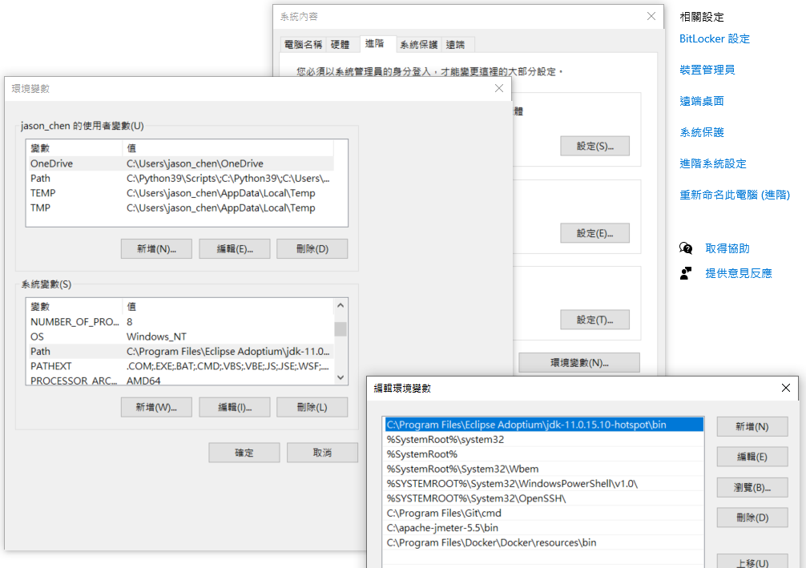
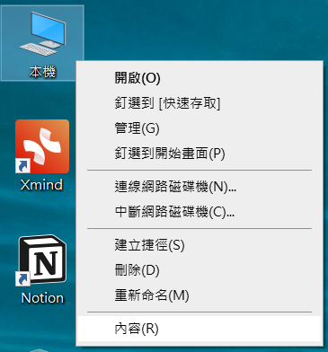
Run JMeter in GUI Mode
Configure PATH

Slide 7
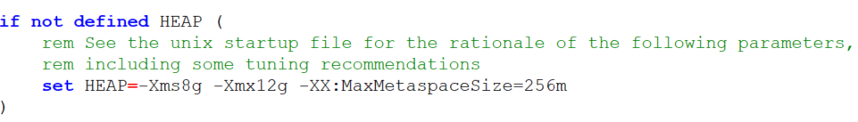
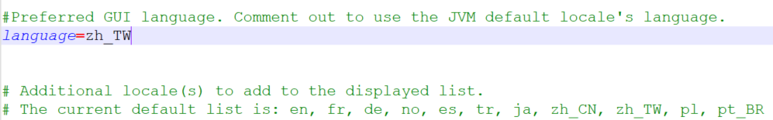
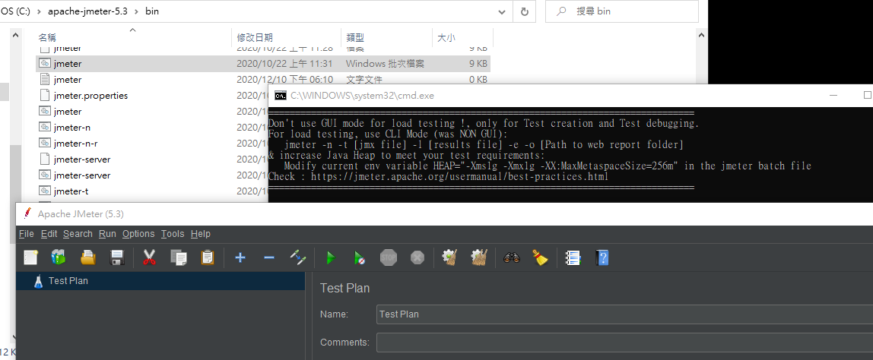
Run JMeter in GUI Mode
Edit jmeter file
(Win) /bin/jmeter.bat
(Unix like) /bin/jmeter
bin/jmeter.properties
Run jmeter
(Win) >jmeter
(Unix like) >./jmeter

Slide 8
簡單認識JMeter
Test Plan (測試計畫)
用來描述一個場景設計，使用JMeter進行測試的所有內容都是基於一個測試計劃
Thread Group (執行緒群組)
模擬使用者執行的工作內容

Slide 9
建立第一個測試腳本
建立一個 HTTP Request
在 Thread Group 上點右鍵
Add → Sampler → HTTP Request
查看執行結果
在 Thread Group 上點右鍵
Add → Listener → View Results Tree
Add → Listener → Aggregate Report

Slide 10
建立 Concurrent User 情境
Thread Properties
Number of Threads (users) (執行緒數量)
Concurrent user 數
Ramp-up period (seconds) (啟動延遲)
在幾秒內達到所設定的Concurrent user 數
Loop Count (迴圈次數)
重複整個 Thread Group 內容的次數

Slide 11
But ...
遇到複雜情境要刻到什麼時候?
使用工具錄製腳本
BlazeMeter - Chrome Extension
https://chrome.google.com/webstore/detail/blazemeter-the-continuous/mbopgmdnpcbohhpnfglgohlbhfongabi?hl=zh-TW
註冊BlazeMeter帳號
https://www.blazemeter.com/

Slide 12
Introducing BlazeMeter
The BlazeMeter Chrome Extension
A free tool to record JMeter and Selenium scripts
support recording JMX, JSON or YML scripts
supports downloading scripts (login required)

Slide 13
練習
在 TZ_UAT 註冊 50 個前台會員帳號

Slide 14
Refine your scripts
根據要進行的測式標的，調整測試的scripts
參數化
提取回應內容
精簡Sampler

Slide 15
Next..
效能測試簡介(三)
如何設計簡單的效能測試情境

